Slide 1
Predicting User Participation in Social Networking Sites
Qingchao Kong, Wenji Mao and Daniel Zeng
Institute of Automation, Chinese Academy of Sciences
Seattle Washington, USA
IEEE ISI, June 5-7, 2013

Slide 2

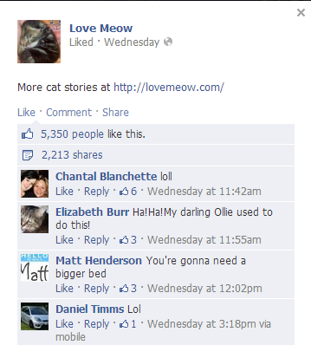
User Behavior in SNS
SNS have become major platforms for people to express opinions and get involved in discussions
Update status
Leave a comment

Slide 3

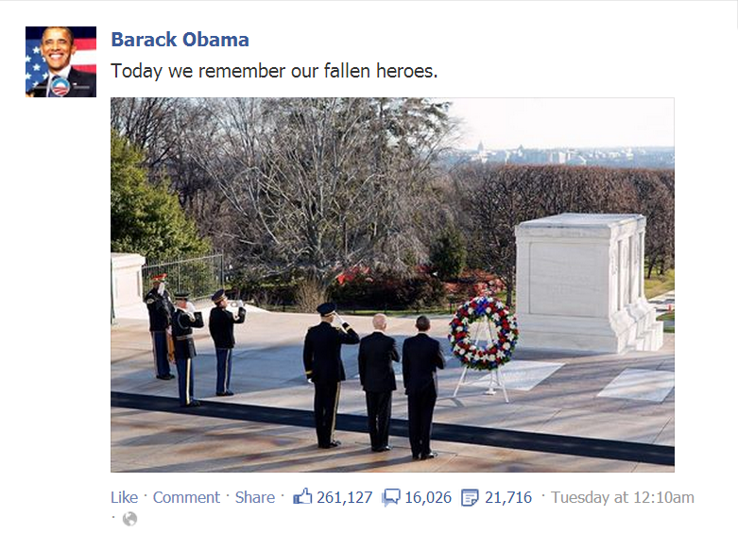
User Behavior in SNS
Add post/photo/video
Like, Comment or Share the post

Slide 4
Discussion Threads
Widely seen in blogs, forums and SNS
Online group discussions are important sources of information
User active participations make discussions spread and evolve very quickly, especially security related topics

Slide 5


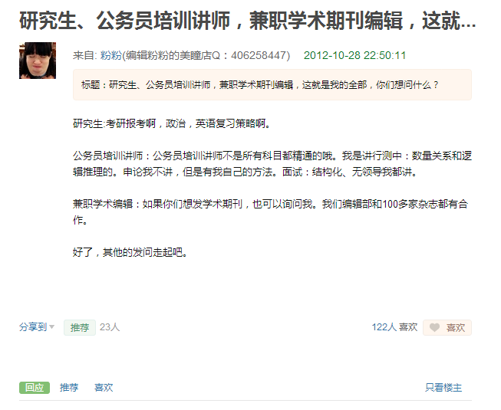
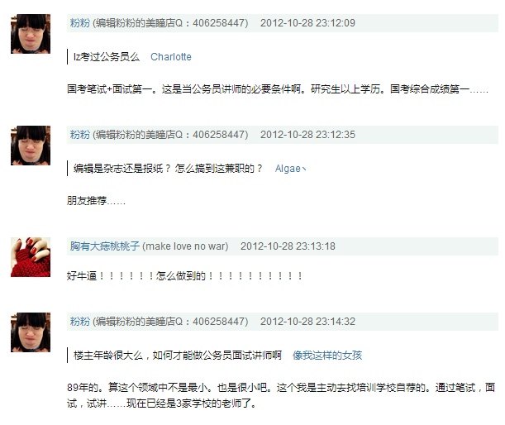
Discussion Groups in SNS

Slide 6
Research Question
Predicting who will leave a comment in a discussion group?
Research applications
Hot topics detection
User personalization and recommendation
Discussion tracking and surveillance

Slide 7
Related Work
Research question | Papers | Drawbacks
Predicting the volume of comments | Using surface, cumulative, textual, semantic & real-world features [Tsagkias et al., 2009] | 1, Only consider volume, ignore comment behavior 2, Mainly consider content and topic information
 | Using topic model based approach [Yano & Smith, 2010]
 | Using feature-based method to predict retweet volume [Hong et al., 2011]
Notes:
Related work已经表示的很清晰，表格表达

Slide 8
Related Work
Research question | Papers | Drawbacks
Predicting who will comment | Using a probabilistic model to generate blog posts and comments jointly [Yano et al., 2009] | Did not consider social and behavioral factors and combine various features in their models
 | Proposing User Interest and Topic Detection model to capture topics and trends [Tang et al., 2012]
Notes:
Related work已经表示的很清晰，表格表达

Slide 9
Related Work
Predicting the volume of comments
Blog Posts
Using surface, cumulative, textual, semantic & real-world features [Tsagkias et al., 2009]
Using topic model based approach [Yano & Smith, 2010]
Retweets
Using feature-based method to predict retweet volume [Hong et al., 2011]
Only consider volume, ignore comment behavior
Mainly consider content and topic information

Slide 10
Related Work
Predicting comment behavior: a more challenging task
Blog
Using a probabilistic model to generate blog posts and comments jointly [Yano et al., 2009]
Forum
Proposing User Interest and Topic Detection model to capture topics and trends [Tang et al., 2012]
Did not consider social and behavioral factors and combine various features in their models

Slide 11
Challenges
User comment behavior is affected by various factors
Thread content interestingness
Authority of thread publishers
User interest and activity level, etc.
Commenting users vs. non-commenting users: not many commenting users for most threads, cause of the class imbalance problem

Slide 12
Our Contributions
Use additional features: behavioral features and social features
Features
Thread features
Content features
Behavioral features
Social features
Ensemble of LRs
Use ensemble of logistic regression (LR) models to solve the class imbalance problem
LR model 1
LR model 2
·
·
·
LR model i

Slide 13
Problem Definition
Given
Publisher of thread d
Content of thread d
User set T of the community
The problem is defined as predicting the probability of a user u in T commenting on thread d

Slide 14
Overview of Our Approach
Inputs
Part I: Model Construction
Part II: Ensemble of LR Models
Part II: Ensemble of LRs
SNS Discussion Group Data
Features
LR model 1
Thread features
Content features
LR model 2
Behavioral features
Social features
·
·
·
Logistic regression (LR) model
LR model i
Prediction Results

Slide 15
Features
Thread features
Length of thread title & content, # of images, etc.
Content similarity
Similarity between thread content and target user’s interest, similarity between thread publisher’s and target user’s interest.
User behavior
# of threads and comments thread publisher and target user have published
Social features
# of followers and followees thread publisher and target user have, etc.

Slide 16
Logistic Regression Model
Logistic regression (LR) model is a linear classification model
Assign probabilities to each test instance indicating how likely it belongs to each class
P_{w}(Y=1|x) : the probability of a user commenting on the given thread

Slide 17
Model training
Training (and test) set construction
Positive instance set (minority class): the commenting users
Negative instance set (majority class): those who didn’t comment
Control the size of negative instance set by adding certain amount of non-commenting users using imbalance ratio R:
Notes:
R controls the imbalanceness of the training set.

Slide 18
Ensemble of LRs: Step 1
Step 1: Split the entire negative instance set (R=3)
N
P
Entire negative instance set
Entire positive instance set
N1
N2
N3
P
Sub negative instance sets
Entire positive instance set
Note: N1, N2, N3 and P are of equal size

Slide 19
Ensemble of LRs: Step 2
Step 2: Create new training sets
P
N1
T1
P
N2
T2
P
N3
T3
New training sets

Slide 20
Ensemble of LRs: Step 3
Step 3: Ensemble of LR models
T1
LR1
Prob. 1
LR2
Average
T2
Prob. 2
T3
LR3
Prob. 3
Prob. of Commenting

Slide 21
Experiment process
SNS Discussion Group Data
Feature
extraction
Preprocessed data
Features
Threads
Training set
Positive
Threads
R
Test set
Negative
Positive
Negative
Negative
Model training
Positive
Commenting users
Top K result
Negative
Non-commenting users
Trained model

Slide 22

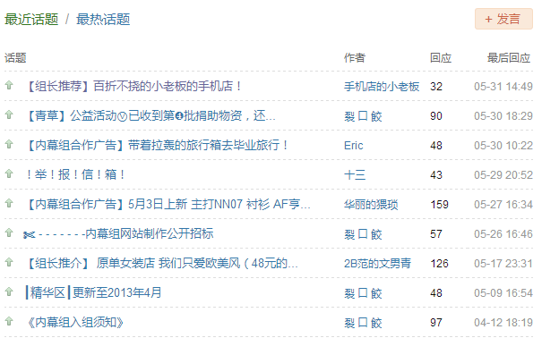
Dataset and Pre-processing
Douban.com: a popular social networking site in China, with over 70 million users
Douban.com homepage
Douban Group
Notes:
Douban Group members can publish, recommend or like a thread.

Slide 23
Dataset and Pre-processing
After pre-processing, every user has at least 2 comments and every thread has at least 5 commenting users in the test set
Statistics of the training and test set
 | # of threads | # of comments | # of users
Training set | 535 | 20473 | 3467
Test set | 112 | 4226 | 708

Slide 24
Evaluation Criterion
Precision and recall are not good options because of the class imbalance problem
We choose Precision@K, commonly used in information retrieval
The prediction framework returns the top K most probable users who will comment

Slide 25
Experimental Results
With and without additional features, i.e. user behavioral and social features
Blue line: without additional features
Red line: with additional features

Slide 26
Experimental Results
Average Precision@5 over all the test threads
 | R=5 | R=10 | R=15 | R=20
Without additional features | 0.39 | 0.28 | 0.23 | 0.20
With additional features | 0.47 | 0.41 | 0.38 | 0.34

Slide 27
Experimental Results
Baseline method: single LR model without ensemble
Blue line: baseline method
Red line: ensemble of LRs

Slide 28
Experimental Results
Average Precision@5 over all the test threads
 | R=5 | R=10 | R=15 | R=20
Baseline | 0.38 | 0.25 | 0.18 | 0.14
Ensemble of LRs | 0.47 | 0.41 | 0.38 | 0.34

Slide 29
Analysis of Results
For each R, the prediction results are not very stable
The prediction result is reasonably good for some threads but not very good for others
When R gets larger, the class imbalance problem becomes more severe and the gap becomes significant
User behavioral and social features do play an important role in prediction

Slide 30
More Results
Two main components of our proposed approach
Base classifier: LR
Sampling method: Under sampling + ensemble
Other base classifiers: decision tree (DT) and AdaBoost
Other sampling methods: random over sampling and SMOTE

Slide 31
Average Precision@5 When R=5
 | DT | LR | AdaBoost
Without sampling | 0.44 | 0.39 | 0.44
Under sampling + ensemble | 0.47 | 0.47 | 0.47
Random over sampling | 0.45 | 0.47 | 0.48
SMOTE | 0.43 | 0.48 | 0.47

Slide 32
Average Precision@5 When R=10
 | DT | LR | AdaBoost
Without sampling | 0.29 | 0.22 | 0.30
Under sampling + ensemble | 0.36 | 0.34 | 0.35
Random over sampling | 0.35 | 0.36 | 0.37
SMOTE | 0.34 | 0.36 | 0.35
Notes:
When R get larger, the class imbalance problem becomes sever

Slide 33
Precision@5 Distributions
Thread Index
Notes:
Precision@K distributions when R=5,10,15,20. Sampling methods=SMOTE, base classifier=LR
Feature-based method is applicable for some certain threads and future work includes finding the properties of those threads.

Slide 34
Precision@10 distributions
Thread Index

Slide 35
Summary
Tackle the user participation prediction problem in social networking environments
Design four types of features, namely thread features, content similarity, user behavior and social features
Use ensemble of LR models to solve the class imbalance problem
Conduct experiment to verify the effectiveness of our proposed approach

Slide 36
Future Work
Explore and analyze a wider range of features to improve the quality of feature engineering
Investigate the performances of different learning models and solutions to class imbalance problem, to refine the prediction method

Slide 37
Thank You!

